Slide 1
Histology Slides
Caitlin Greer
Period 2

Slide 2
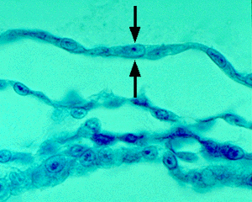
Simple Squamous Epithelium
(cross section)

Slide 3
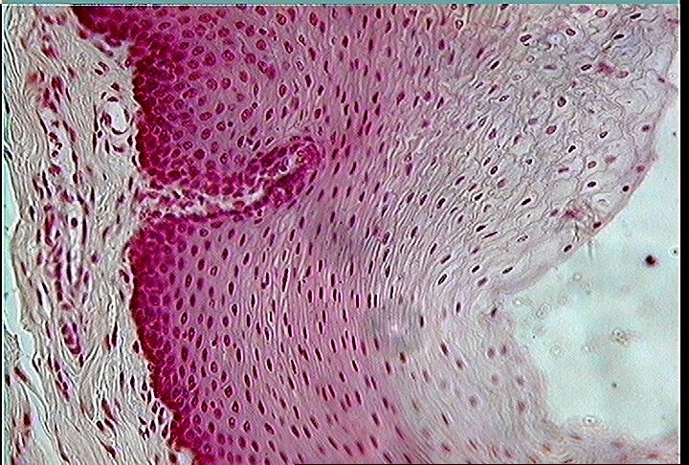
Stratified Squamous Epithelium

Slide 4
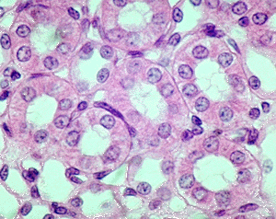
Simple Cuboidal Epithelium

Slide 5
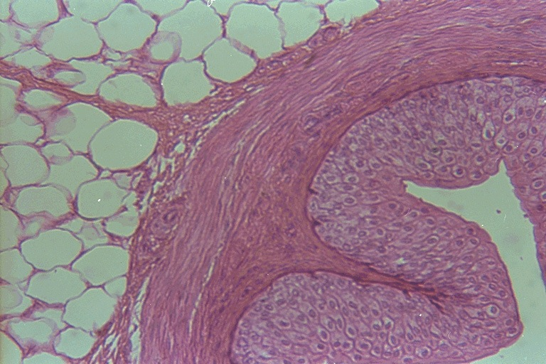
Transitional Epithelium

Slide 6
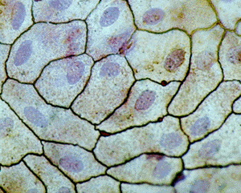
Simple Square Epithelium
(top view)

Slide 7
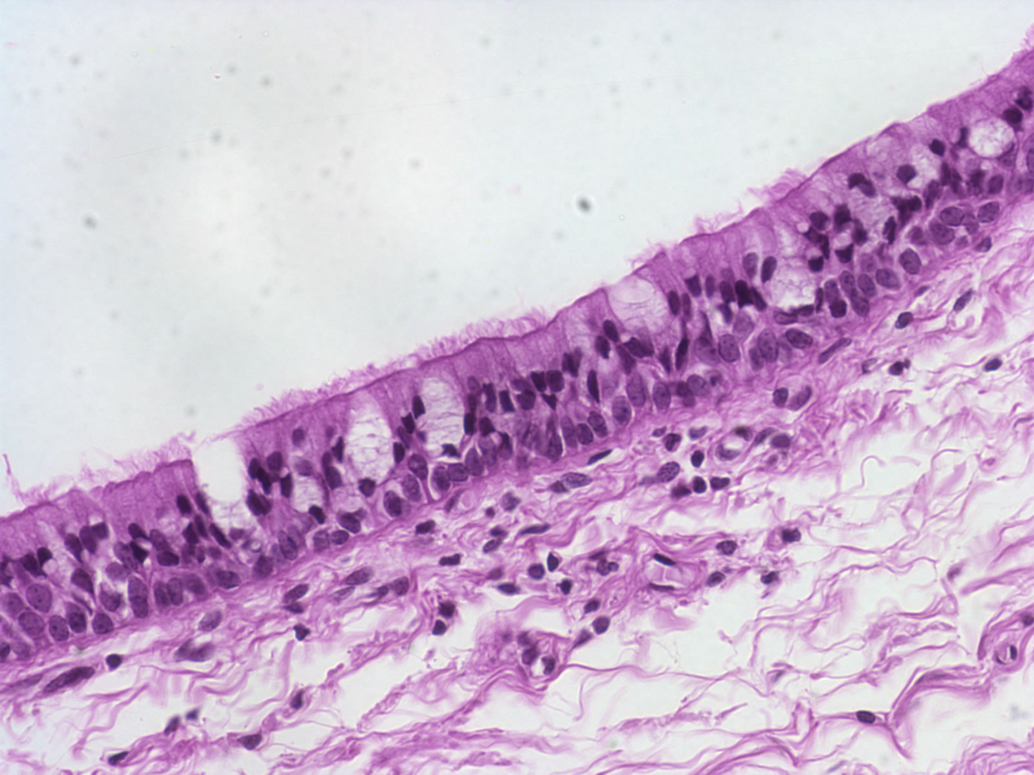
Pseudostratified Columnar Epithelium

Slide 8
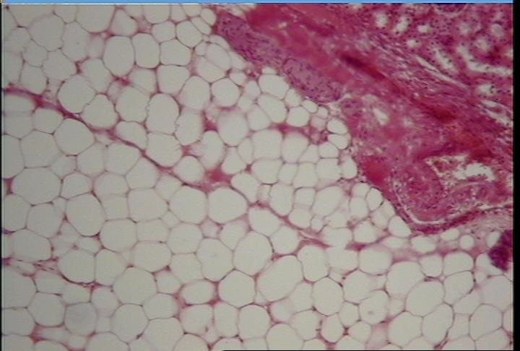
Adipose Tissue

Slide 9
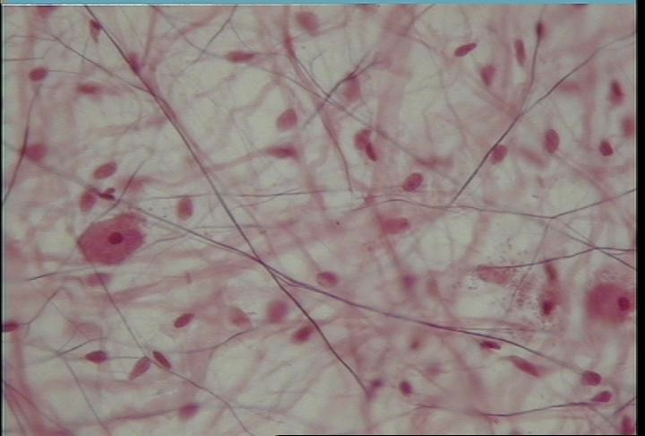
Loose Connective Tissue (Aerolar Tissue)

Slide 10
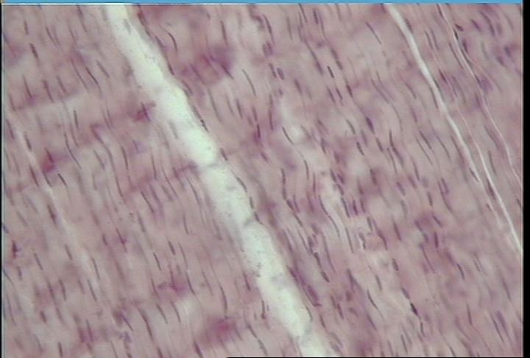
Dense Regular Connective Tissue (Longitudinal Section)

Slide 11
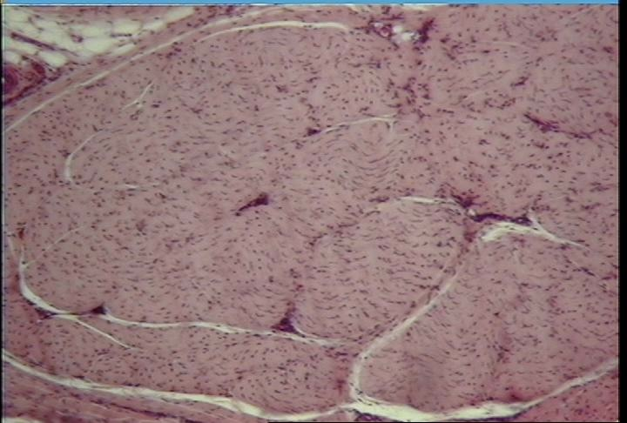
Dense Regular Connective Tissue (cross section)

Slide 12
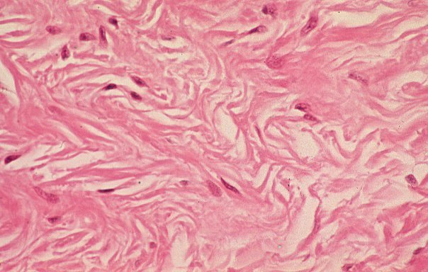
Dense Irregular Connective Tissue

Slide 13
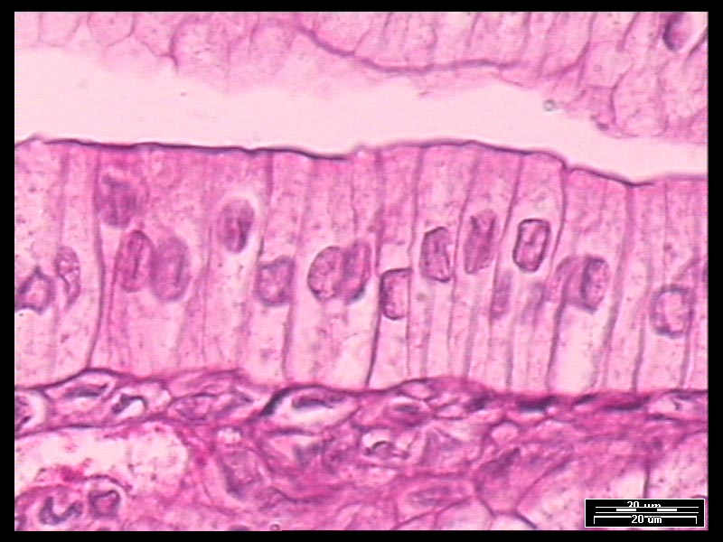
Simple Columnar Epithelium

Slide 14
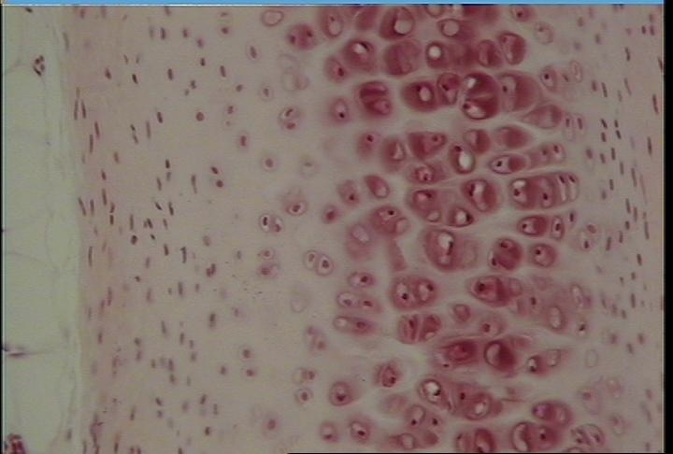
Hyaline Cartilage

Slide 15
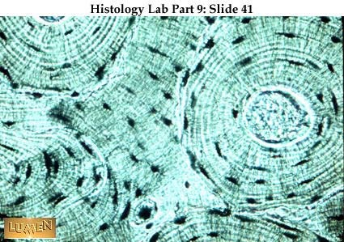
Compact Bone (c.s.)

Slide 16
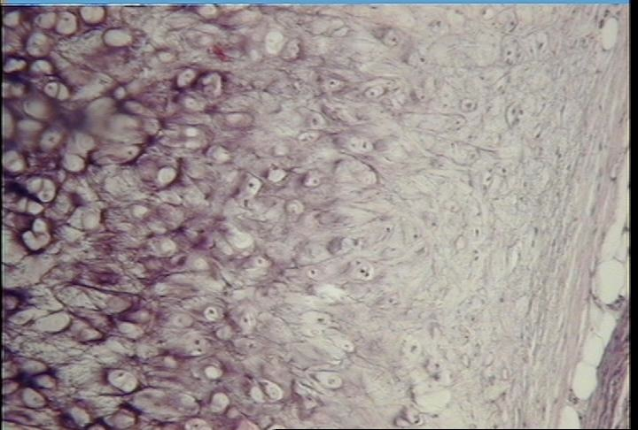
Elastic Cartilage

Slide 17
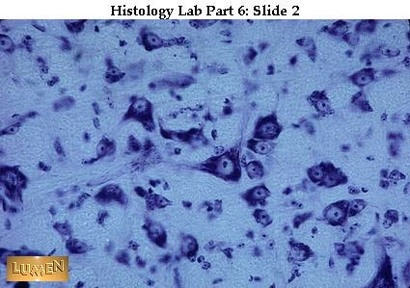
Nerve Tissue

Slide 18
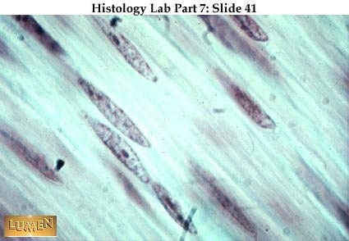
Smooth Muscle

Slide 19
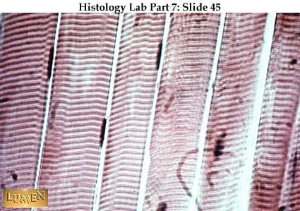
Skeletal Muscle

Slide 20
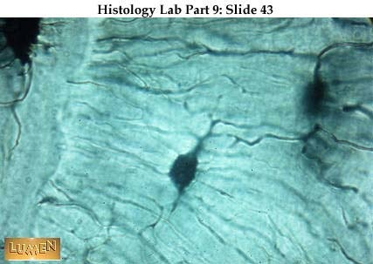
Compact Bone

Slide 21
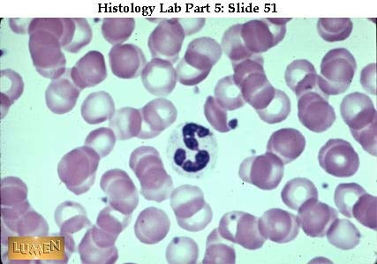
Blood

Slide 22
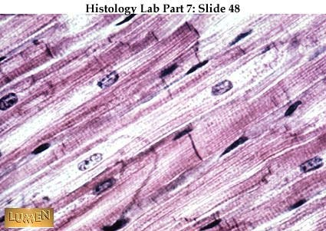
Cardiac Muscle

Slide 23
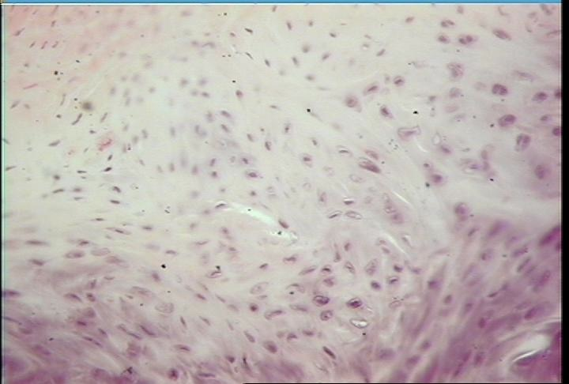
Fibrocartilage

